Slide 1
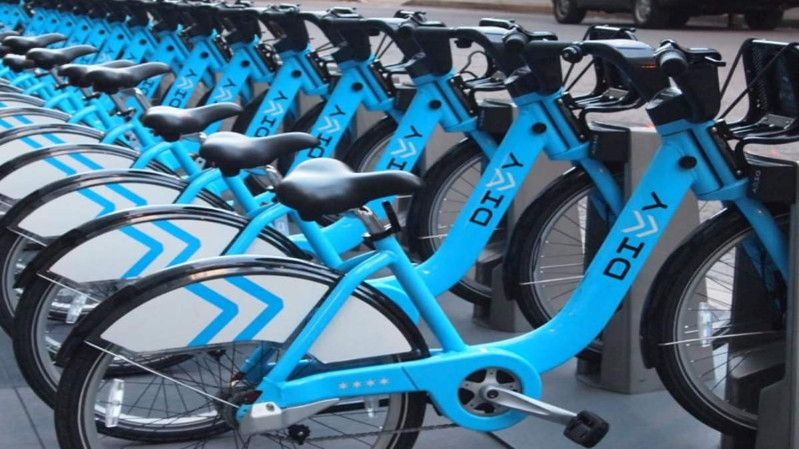
Divvy Bikeshare
Aenugu nema
Sumanth Srivatsav balijepalli

Slide 2
01
Business Target
Agenda
Objective
CONTENTS
Description of data
02
03
Transformation of Data
Data Reading
04
Data Analysis
Year wise top stations
How many road trips
Most popular paths
Trip distribution
05
Findings & Conclusion

Slide 3
INTRODUCTION (Business Target)
The agenda of project is to promote sharing of bikes in groups to achieve a healthier and more environmentally conscious way of life.
In the current work-life patterns, people prefer their own mode of transport which leads to environmental degradation.
To minimize environmental degradation, public transport like bicycles which are environmentally friendly would definitely be helpful to environment, people also to public transport authorities to supplement buses, trains etc. which would be more economic.

Slide 4
OBJECTIVES
To know (understand) the times where people use bikes and recourse it accordingly.
To identify the popular stations (high demand) and pay more attention on them by increasing the number of available bikes at that station and to the stations that has less traffic which in-turn would help to re-think about the locations either to change the location of the existing station or to open a new station.
To know the busiest days, which would help to allocate recourses accordingly.

Slide 5
DESCRIPTION OF DATA
Source of data is from Divy bike share data website which contains data of 7 consecutive years from 2015 – 2022.
(https://divvy-tripdata.s3.amazonaws.com/index.html)
These files contains information on the stations where the bikes are docked.
We have pre-processed the data to a specific format and then started analyzing according to business need.
Column Name | Type
TRIP ID | Number
START TIME | Date & Time
STOP TIME | Date & Time
BIKE ID | Plain Text
TRIP DURATION | Number
FROM STATION ID | Plain Text
FROM STATION NAME | Plain Text
TO STATION ID | Plain Text
TO STATION NAME | Plain Text
USER TYPE | Plain Text
GENDER | Plain Text
BIRTH YEAR | Number
FROM LATITUDE | Number
FROM LONGITUDE | Number
FROM LOCATION | Point
TO LATITUDE | Number
TO LONGITUDE | Number
TO LOCATION | Point
Table -1 Data Attributes

Slide 6
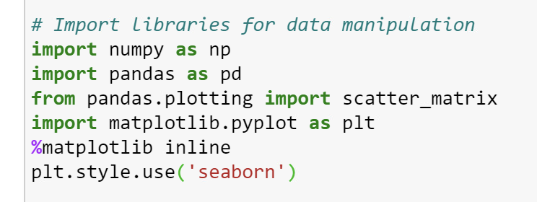
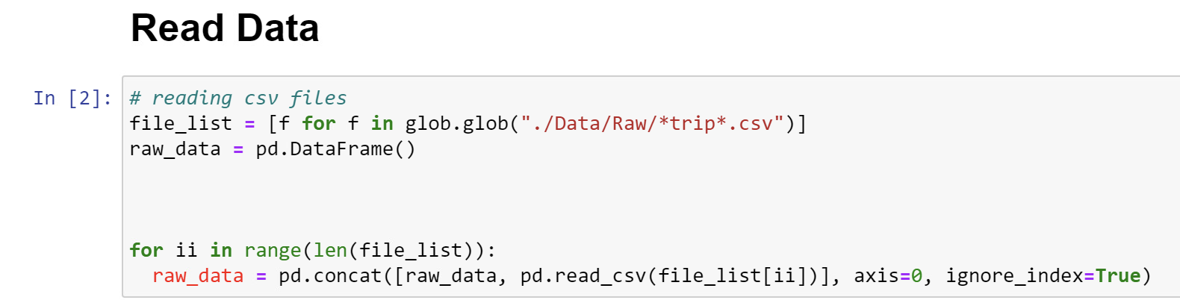
TRANSFORMATION OF DATA (Exploratory data analysis)
The developed Python script makes use of Pandas package.
We downloaded, unzipped all csv files and stored them to a folder Data/Raw as mentioned below in Fig-2.
Fig-1
Fig-2

Slide 7
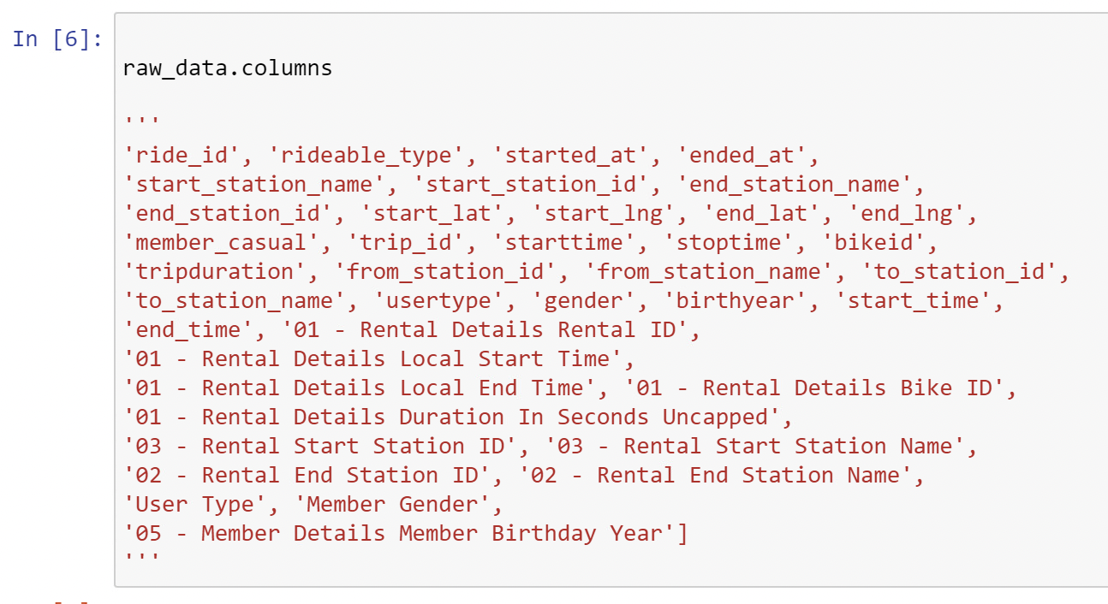
TRANSFORMATION OF DATA (Exploratory data analysis)
Each csv file is read into a dataframe one after the other using pandas and then they are merged into a final raw csv file using concatenation
Reading and merging raw files is done initially.
Data from each year is stored in different format under varying attribute names.
We have reformatted the data to make it consistent and coherent.
From Fig-3 we can see that multiple variable names appear to contain the same information but are named differently.
To make it consistent for analysis, we merged different columns containing the same information
Fig-3 Raw Data Attributes

Slide 8
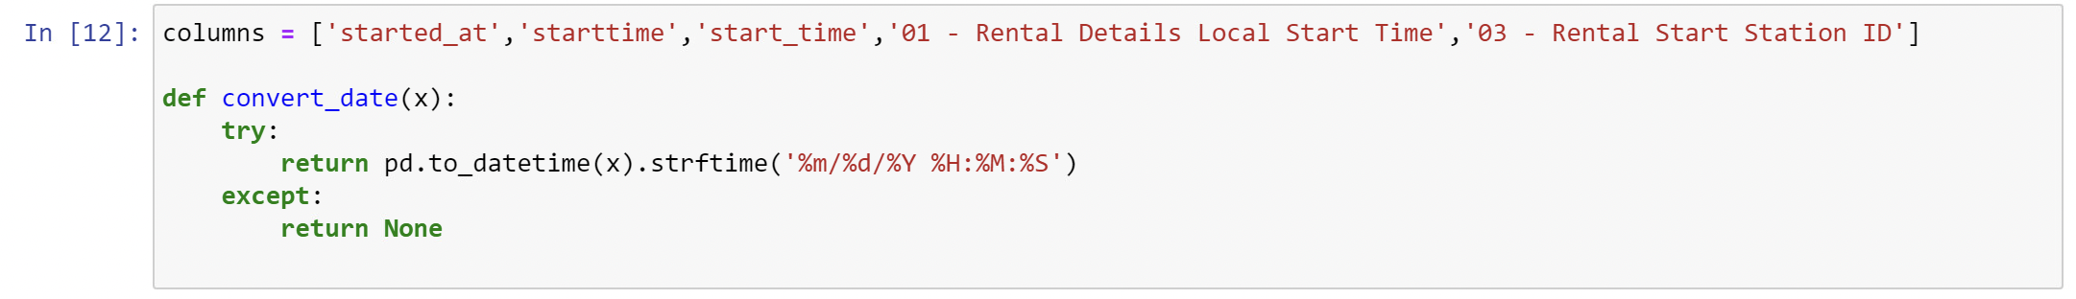
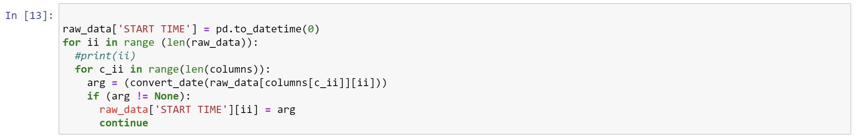
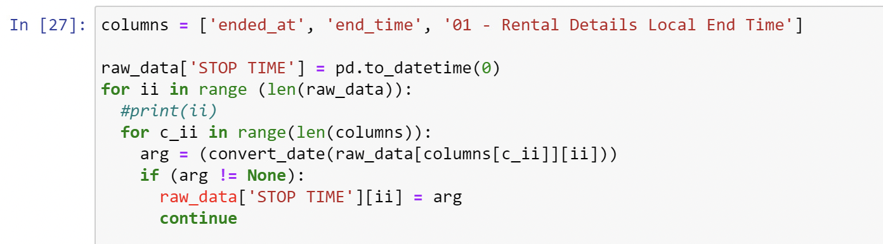
TRANSFORMATION OF DATA (Exploratory data analysis)
First, we worked on getting date and time to a format ( mm-dd-yyyy hh-mm-ss) information.
Fig-4 Date Formatting

Slide 9
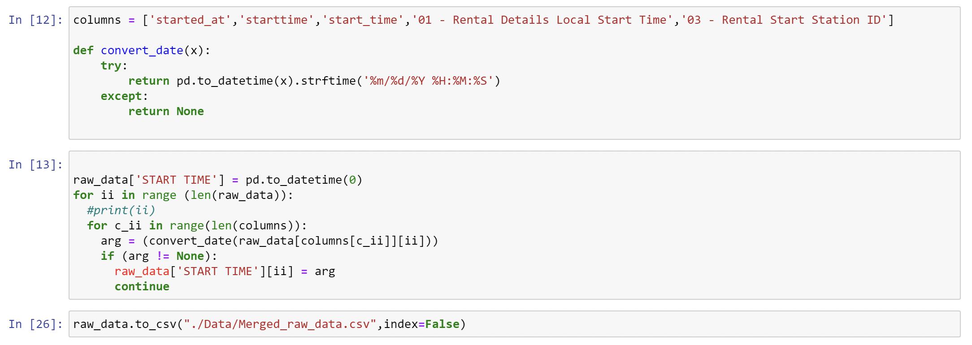
TRANSFORMATION OF DATA (Exploratory data analysis)
Reformatted data is stored into a new merged file “Merged_raw_data.csv”
Fig-5 Date Formatting, Data writing

Slide 10
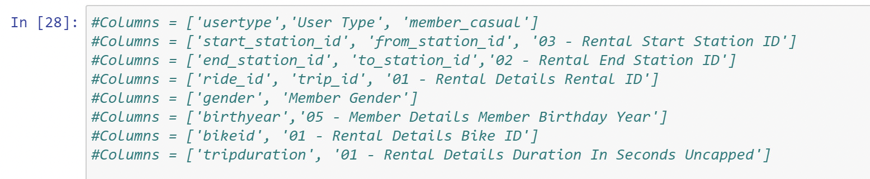
TRANSFORMATION OF DATA (Exploratory data analysis)
Attributes mentioned in Table-1 are re-formatted and saved into a new csv file “MasterTable2.csv”
Fig-6 Columns needed and used for data analysis
Column Name | Type
TRIP ID | Number
START TIME | Date & Time
STOP TIME | Date & Time
BIKE ID | Plain Text
TRIP DURATION | Number
FROM STATION ID | Plain Text
FROM STATION NAME | Plain Text
TO STATION ID | Plain Text
TO STATION NAME | Plain Text
USER TYPE | Plain Text
GENDER | Plain Text
BIRTH YEAR | Number
FROM LATITUDE | Number
FROM LONGITUDE | Number
FROM LOCATION | Point
TO LATITUDE | Number
TO LONGITUDE | Number
TO LOCATION | Point
Table -1 Data Attributes

Slide 11
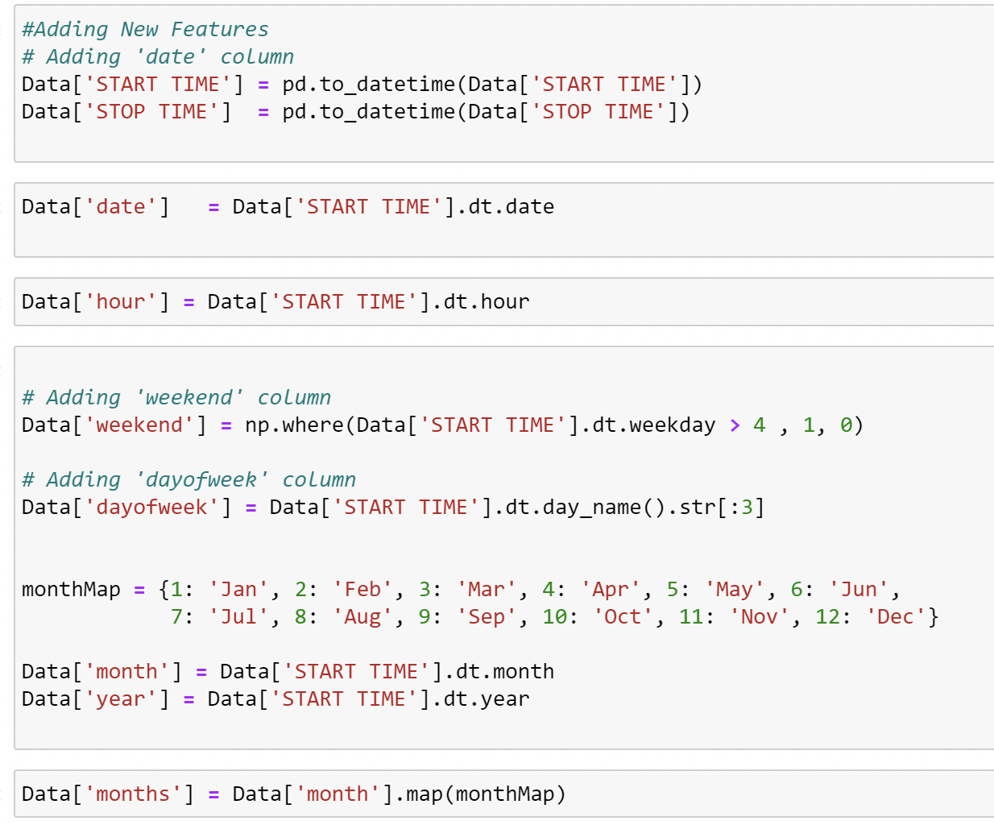
TRANSFORMATION OF DATA (Exploratory data analysis)
New features start time, stop time, day of week, weekday, weekend, month numbers have been mapped to words using dictionary.
Fig-7 Adding features & mapping months in words

Slide 12
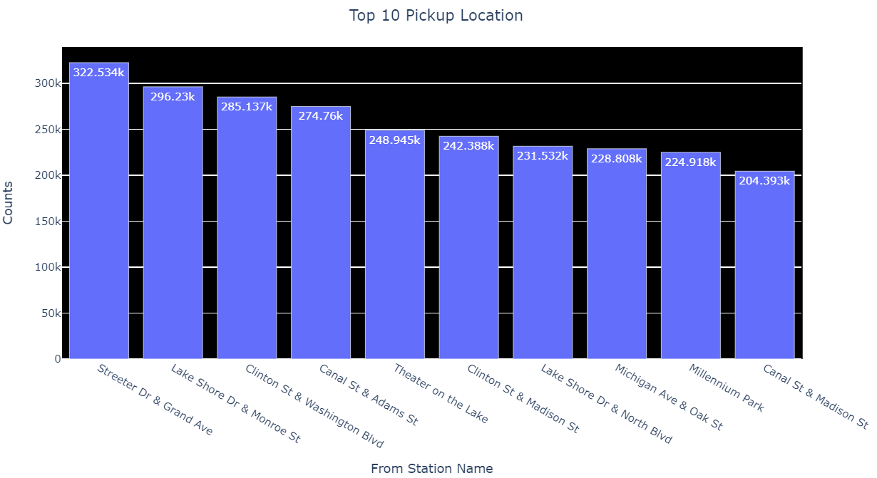
DATA ANALYSIS (year wise top stations)
To solve business problem, we have found out top 10 pickup stations from the processed merged file.
Top 10 popular stations to begin a ride at?
Fig-8 Top 10 Popular pickup Stations

Slide 13
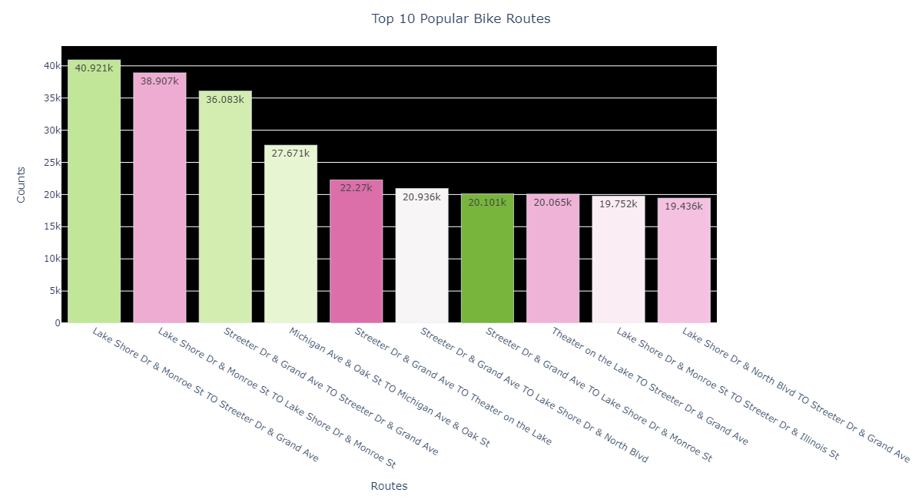
DATA ANALYSIS (Popular Paths)
To solve business problem, we have found out top 10 pickup stations from the processed merged file.
Top 10 popular bike routes
Fig-10 Top 10 popular bike paths

Slide 14
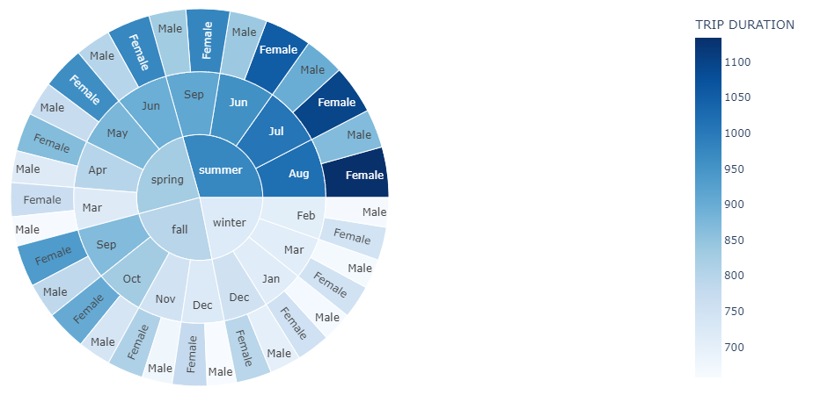
DATA ANALYSIS (Seasonal distribution of trips)
To solve business problem, we have found out top 10 pickup stations from the processed merged file.
Seasonal distribution of trips
Fig-11 Seasonal distribution of trips

Slide 15
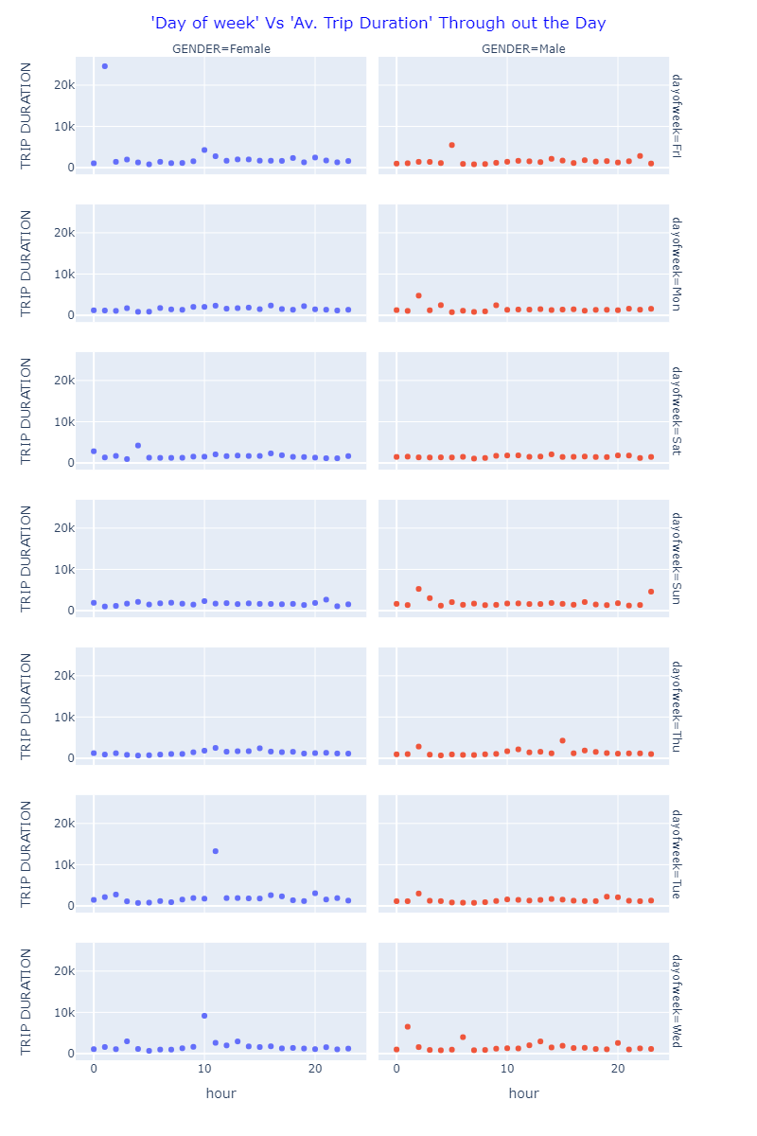
DATA ANALYSIS (Trip distribution by gender and day of the week)
Trip distribution by gender and day of the week
Fig-12 Trip distribution by gender and day of the week

Slide 16
CONCLUSION AND FINDINGS
We did develop our python script from the raw data containing the information about the rides of 7 consecutive years from 2015-2022.
We did find the count and calculated the percentage of round trips and we found them to be 787,236 and 3.71%. respectively.
These findings are important from business point of view because the service provider needs to rebalance the bikes from low-demand to high-demand stations.
When it comes to the usage of bikes over a period of 7 years, we observe the upward graph in the usage both my male and female riders having Lake Shore Drive & Monroe Street to Streeter & Grand Ave being the most popular routes.
The graph pattern is also observed to be upward in summers and decreasing gradually during the winter months.

Slide 17
THANK YOU

